Slide 1
STAT 717: Lecture 4
Test on one ore two mean vectors
Vitaly Druker
September 23rd, 2021

Slide 2
Multivariate v Univariate Tests

Slide 3
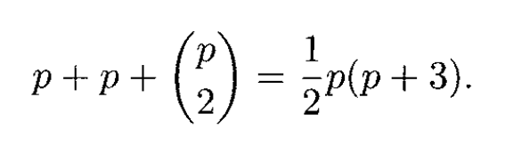
Total parameters

Slide 4
Issues
Type I error is inflated
P(>0 rejections) = 1 – (P no rejection) = 1 – (.95)^10 = .40
Under what conditions is the above true? Why is not a reasonable assumption?
Univariate Test ignore correlations
This may lead to a more powerful test
What is power and why is it important?
Lack of information about linear combinations
Some multivariate tests let you learn about combinations of the variables

Slide 5
Test on mu with Sigma known

Slide 6
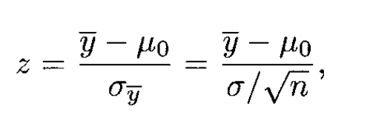
Review of univariate test when sigma is known
Z is distributed as N(0, 1) if H0 is true.
Does this ever happen?

Slide 7


Multivariate test for H0 with known Sigma
Z squared is distributed as $χ_{p}^{2}$ and reject H_0 if Z^2 > $χ_{α, p}^{2}$

Slide 8
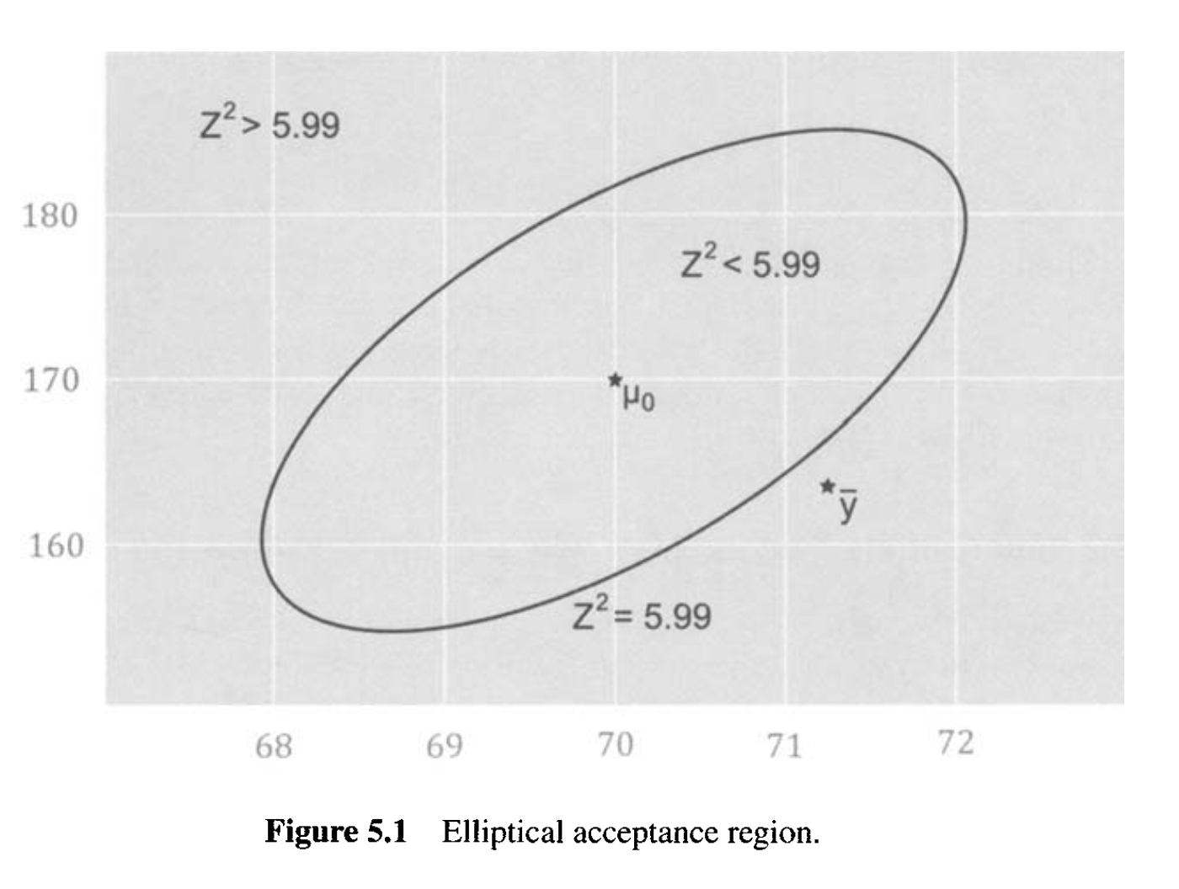
Acceptance Region

Slide 9
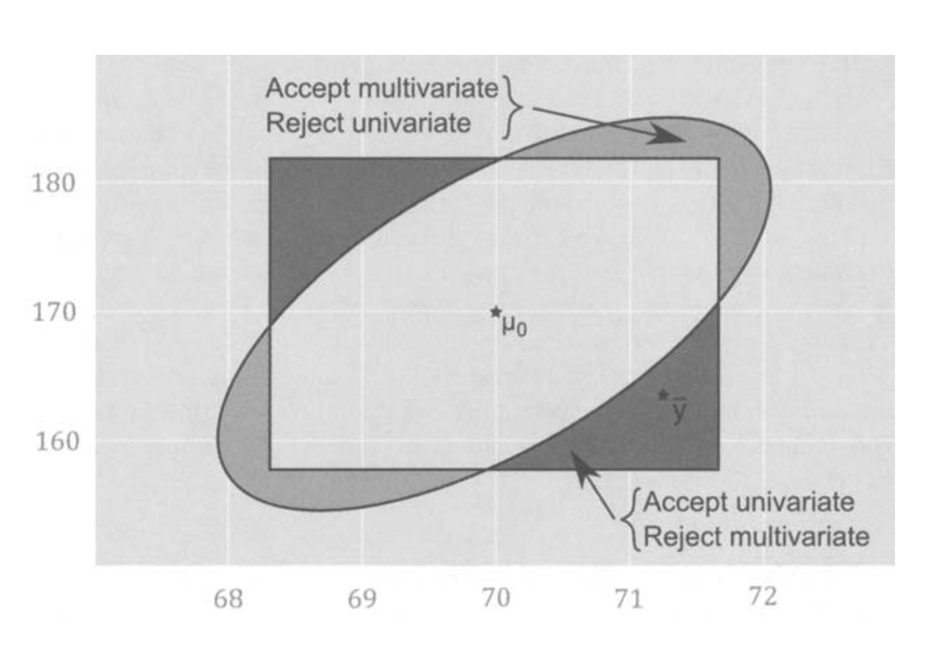

Slide 10
Test on mu with Sigma unknown

Slide 11
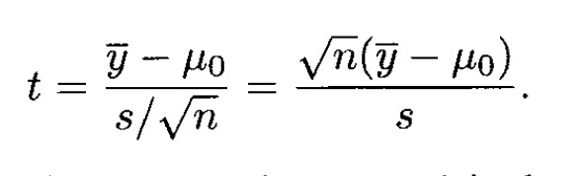

Review of univariate t-test
Where t is distributed as $t_{n−1}$

Slide 12
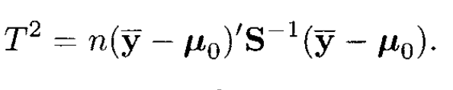
Hotelling’s T^2 Test

Slide 13
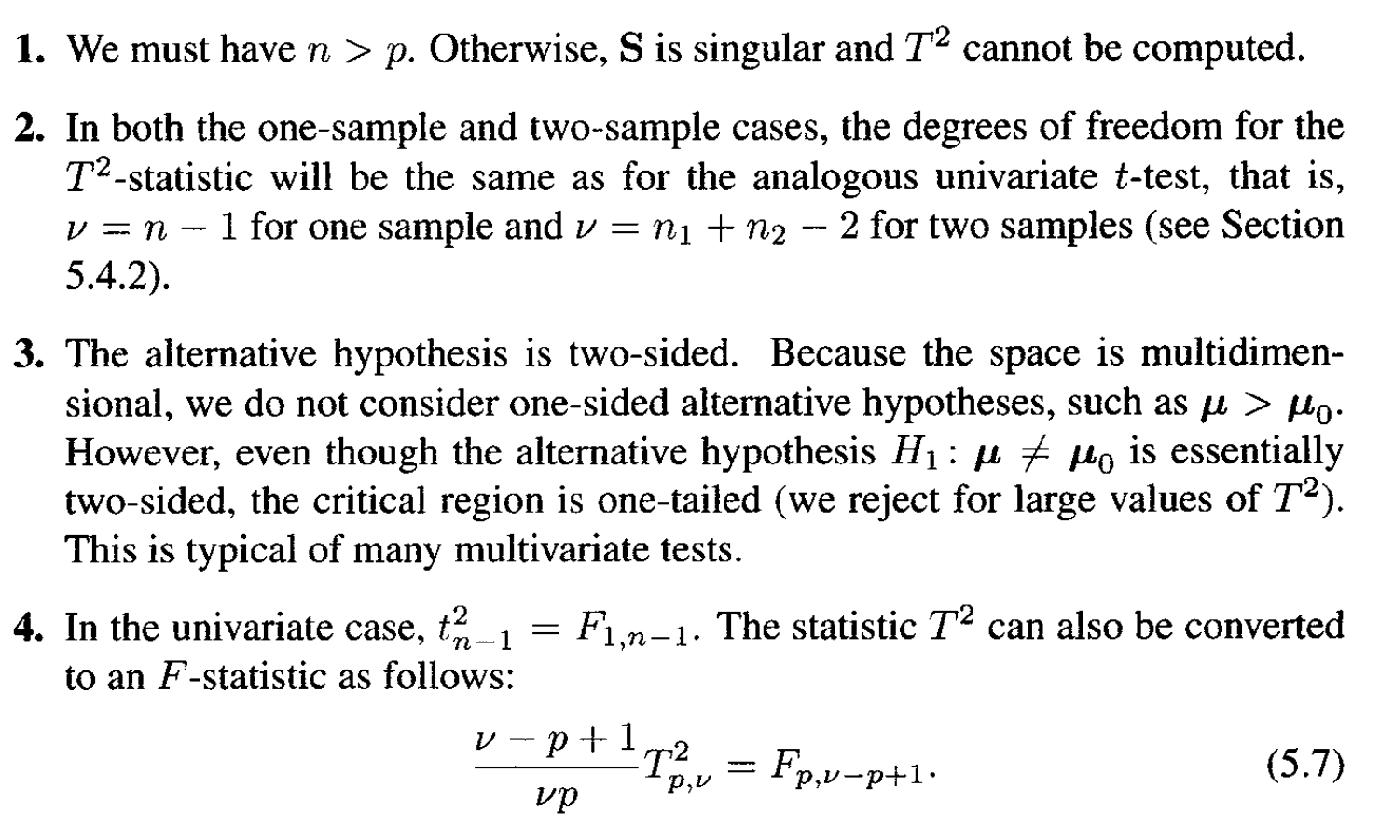
Key Properties

Slide 14
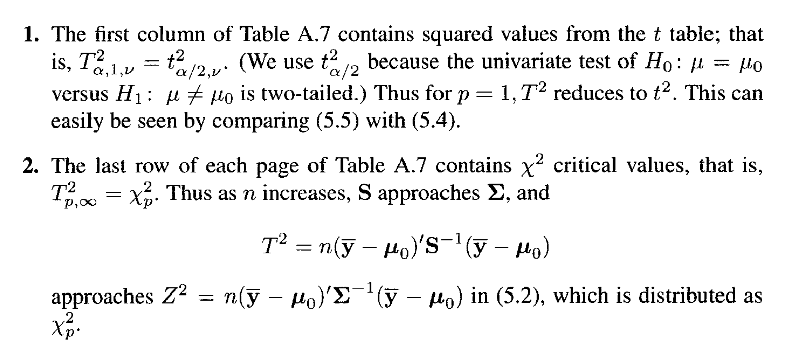
Properties of T2 statistics

Slide 15
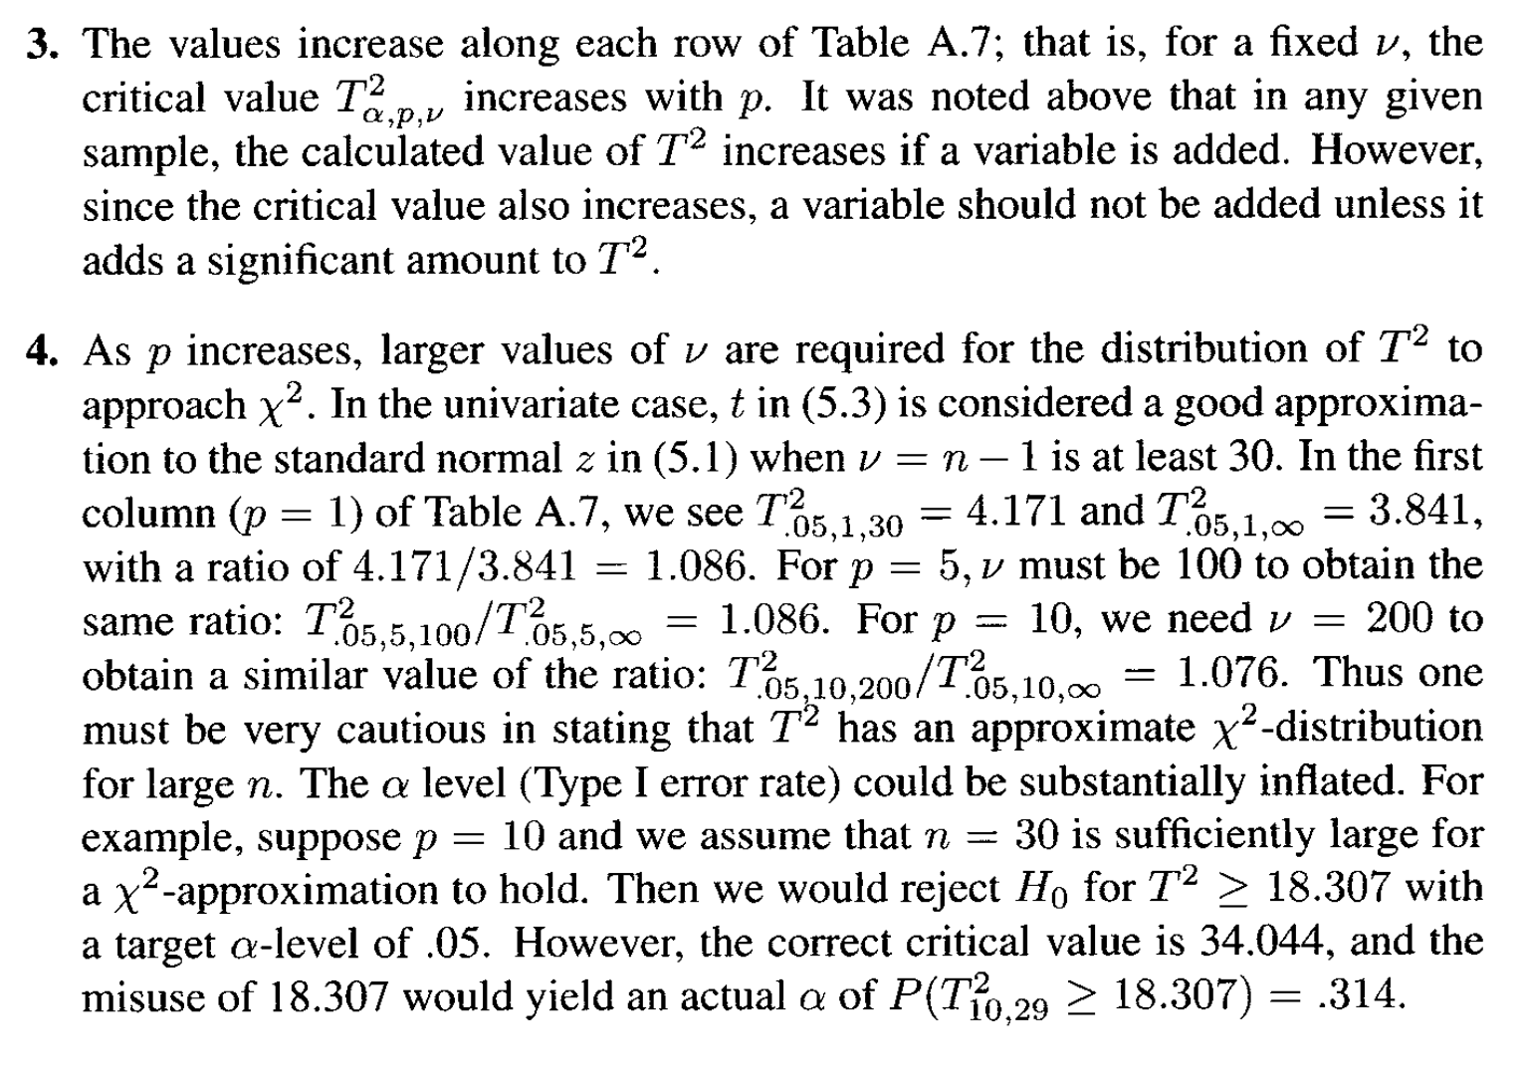
Properties of T2 statistics (cont.)

Slide 16
Comparing two mean vectors

Slide 17
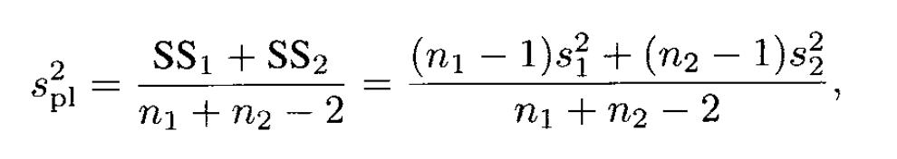
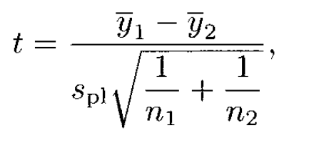
Review of univariate two-sample t-test
Assuming equal variance
Pooled Variance:
Which has a t-distribution with n1 + n2 -2 degrees of freedom

Slide 18
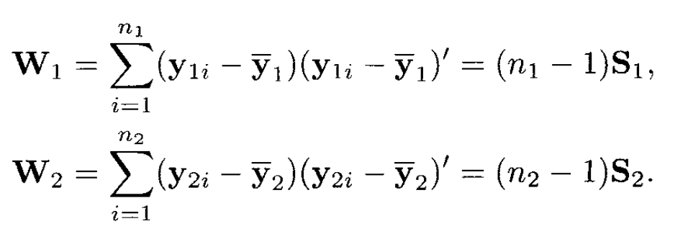
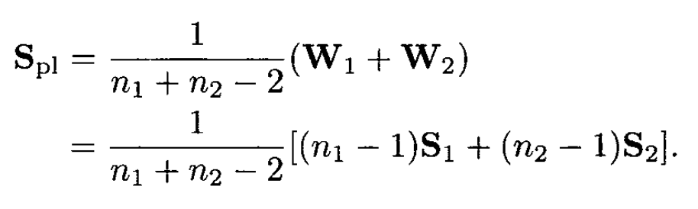
Multivariate two-sample T2 Test
Assume variances are equal but unknown

Slide 19
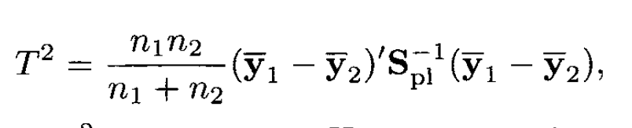
Multivariate two-sample T2 Test (cont)

Slide 20
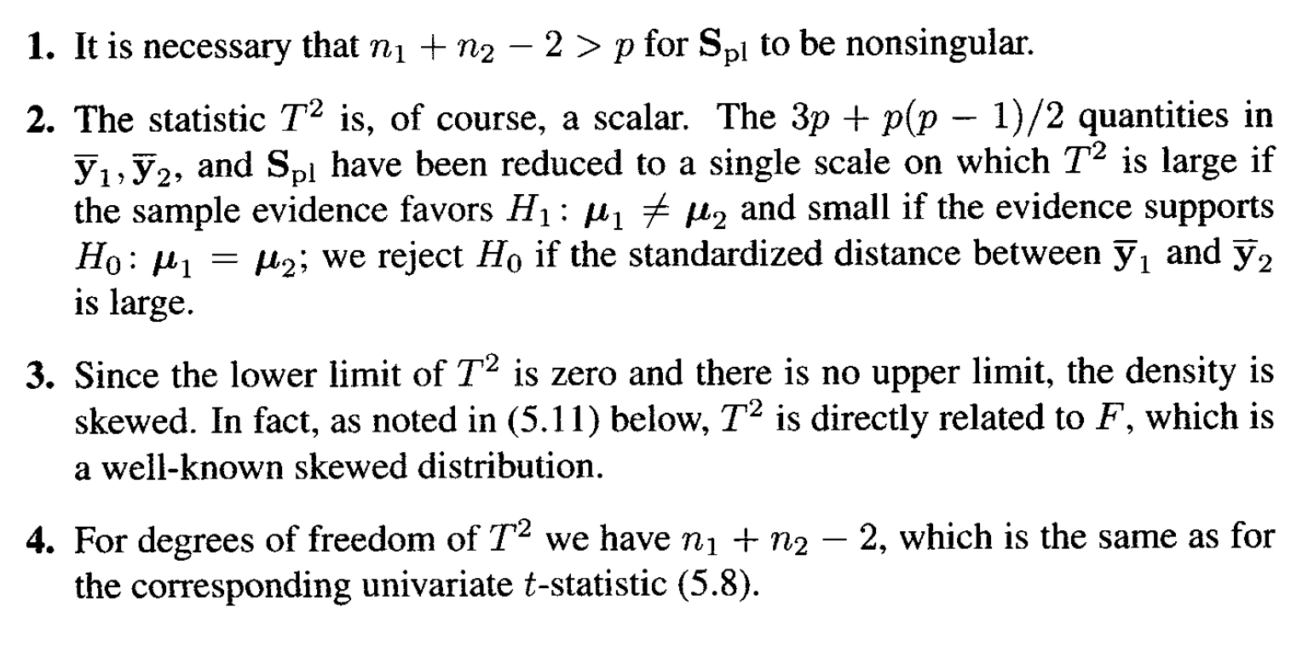
Key properties

Slide 21
Likelihood Ratio
The T2 test is the same as the likelihood ratio test.
Same as in the univariate case

Slide 22

Tests on Individual Variables Conditional on Rejection of H0 by the T2 test
If the hypothesis is rejected then $μ_{1j}≠u_{2j}$ for at least one j.
However, there is no guarantee that the univariate test will find that vector

Slide 23

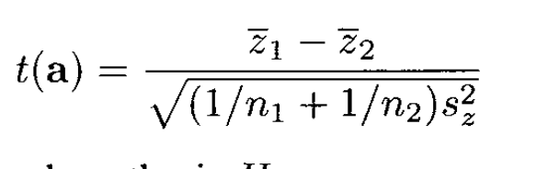
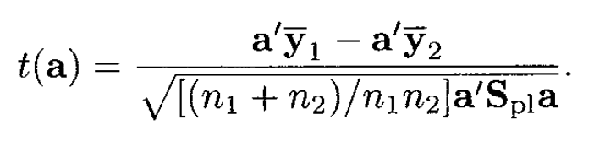
Linear Combination of values
Then there exists at least one coefficient vector a for which
Will reject the null hypothesis
Use this and square it
We seek an a such that the distance between ybars is maximized

Slide 24
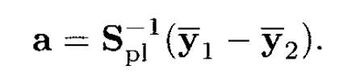
Maximizing t2
Maximizes t2
We can then examine each a for contribution to rejection of H0

Slide 25

Other procedures for checking variables
1. Univariate t tests for each variable
2. Use different critical values (Bonferroni )
3. Protected vs unprotected test
See Examples for simulation and exploration of experimentwise error rate

Slide 26
Paired Observations Test

Slide 27
Issues with independent sample test
Why can’t we use the test from the previous section?

Slide 28
Instead…
We use a test against a hypothesis of 0 for the difference. Normal single sample test

Slide 29
Tests for additional information

Slide 30
Motivation
Do new variables on the same samples?
This is similar to a question of full vs reduced model in regression

Slide 31
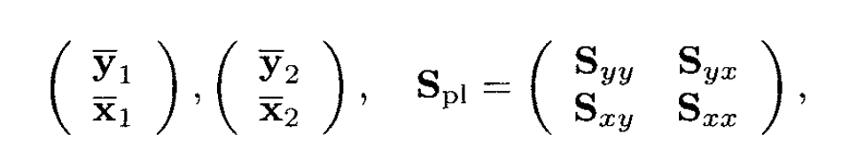
Set up
Full data set contains p + q variables.
We are comparing two groups to see if they are different
Do the q extra variables help determine if group 1 and group 2 are different?
Partion data such that subset 1 is p variables, 2 is from the q variables

Slide 32
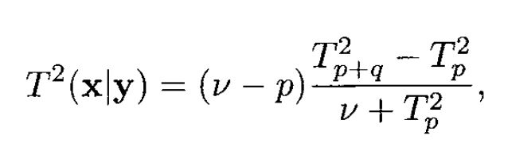

Test statistic
Calculate T2 for p and p + q
Calculate new test statistic
Where v is n1 + n2 -2
Compare to T2 stat and reject if:

Slide 33
Profile Analysis

Slide 34
Homework
Evaluate the power differences between the multivariate T2 test and other options try to use at least 10,000 samples
Use the code in the example as a starting point. Simulate data so that the the average pictoral test is 1 unit higher in d2
What’s the power of detecting a difference in d1 and d2 using the multivariate T2?
What’s the power of finding a difference in just the pictoral column?
Comment on the difference between this and the previous power
What’s the power of finding a difference between the two data sets using procedure 1 or procedure 2 in the book? What’s the problem with using these two methods?
What’s the power of the pictoral column having the largest determinant value given the multivariate T2 was significant?
Evaluate the ‘additional information’ T2 statistics.
Using the parameters above, add a new ‘column’ to the output data frame which checks to see how often:
The first two columns (pictoral and paper) help split the data
The second two columns (tool and vocab) help to split the data

